Slide 1


Spatial and Temporal Dynamics of Dengue Healthcare Data
Presented To: Dr. Muhammad Awais Hassan
Presented By: Aqib Javaid 2024-MS-DS-129
Institute of Data Science,
University of Engineering and Technology Lahore.
CS-608 Advanced Techniques in Data Science

Slide 2
Problem Statement and Motivation
Problem Statement:
Dengue fever’s spatial and temporal dynamics challenge healthcare systems.
Objective: Provide actionable insights for epidemic control.
Motivation:
Understand geographical hotspots.
Analyze demographic and seasonal patterns for better preparedness.
CS-608 Advanced Techniques in Data Science

Slide 3
Objectives
Spatial Analysis: Identify geographical hotspots using clustering and heatmaps.
Temporal Trends: Analyze time-based patterns and anomalies.
Demographics: Explore age and gender distributions.
Predictive Modeling: Use ML for forecasting and hotspot intensity estimation.
CS-608 Advanced Techniques in Data Science

Slide 4
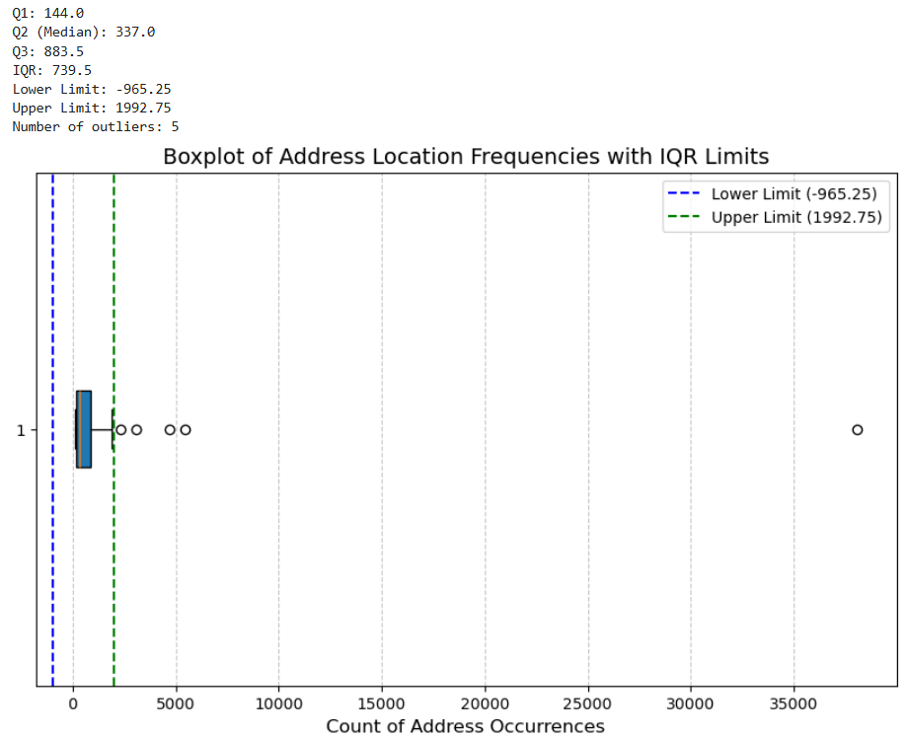
Data Wrangling (Preprocessing)
Missing values handled via modes or dropped.
Address standardization and mapping to coordinates.
Outliers identified using IQR for complaints and age.
Features engineered: Age groups, latitude/longitude, month extraction.
CS-608 Advanced Techniques in Data Science

Slide 5
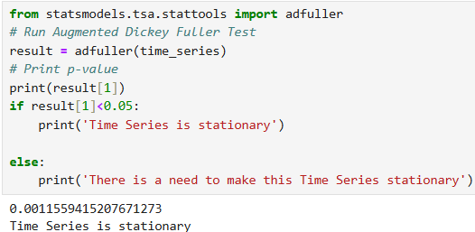
Analysis Techniques
Spatial Analysis:
Hotspot generation using SVM with RBF kernel.
Visualized intensity via Folium heatmaps.
Temporal Analysis:
Stationarity Check:
Conducted using the Augmented Dickey-Fuller (ADF) test.
Null Hypothesis (H₀): The time series is non-stationary.
Results: Rejected H₀ confirming stationarity.
Time-series trends using STL decomposition for seasonality and anomalies.
Detected anomalies with IQR on residuals.
CS-608 Advanced Techniques in Data Science

Slide 6
Analysis Techniques
CS-608 Advanced Techniques in Data Science

Slide 7
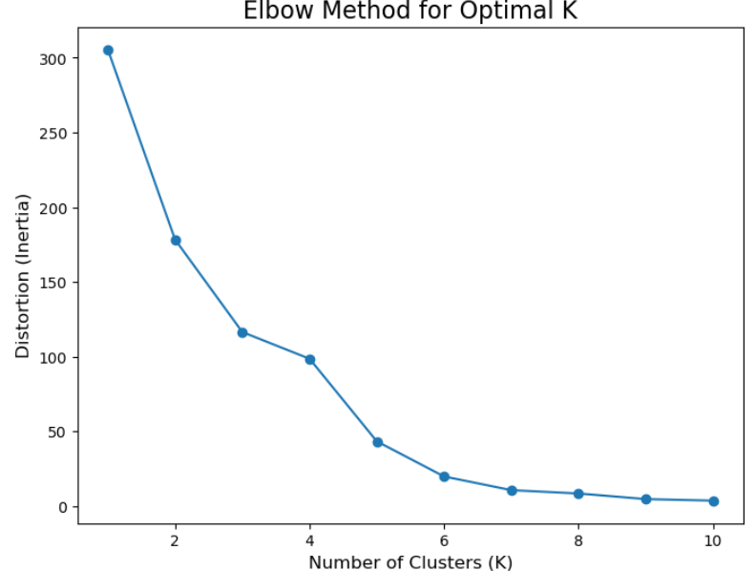
Data Aggregation using K-Means
Aggregated dengue cases by gender, month, and location.
K-Means clustering with optimal k determined by the Elbow Method.
Clustered data visualized on Folium maps.
Females-May Males-May
CS-608 Advanced Techniques in Data Science

Slide 8
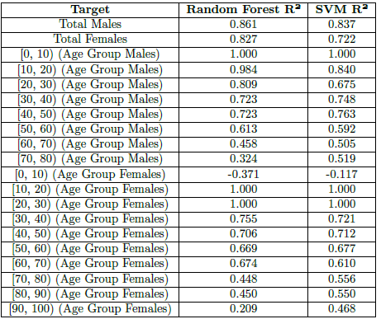
Predictive Modeling
Approach:
Targeted prediction: Total males, females, and age group distributions.
Models Used:
Random Forest Regression: Captures non-linear patterns.
SVR (RBF Kernel): Maps data to higher-dimensional spaces for accuracy.
Evaluation Metrics: R², MAE, MSE.
CS-608 Advanced Techniques in Data Science

Slide 9
Log Transformation for Optimization
Purpose:
Stabilize variance and reduce outlier effects.
Improve regression performance for skewed data.
Impact:
Enhanced R², reduced MAE and MSE for both Random Forest and SVR models.
CS-608 Advanced Techniques in Data Science

Slide 10
Results and Discussion
Key Findings:
Random Forest outperformed SVR in overall R².
Log transformation significantly improved model predictions.
Conclusion:
Random Forest is more robust for this problem, while SVR has niche strengths.
CS-608 Advanced Techniques in Data Science

Slide 11
Conclusion and Future Work
Conclusion:
Insights gained in dengue trends by location, time, and demographics.
Predictive models can assist in resource allocation.
Future Directions:
Incorporate additional features for forecasting (e.g., weather data).
Extend analysis to recent datasets for better applicability.
CS-608 Advanced Techniques in Data Science

